Slide 1

Capstone Project – Final: Review – 2 on
Predicting high increases in stock prices using text mining and data resampling techniques
Presented by the Batch No. : 12
Anurag.V – VU22CSEN0500151
Ambati Karthik – VU22CSEN0500097
Bibek – VU22CSEN0500205
Abhishek – VU22CSEN0500101
Under the Guidance of
Dr. Godi Appa Rao
Assistant Professor
Department of Artificial Intelligence & Data Science
GITAM School of CSE, GITAM (Deemed to be University),
Visakhapatnam, INDIA.

Slide 2
CONTENTS
Recap of Capstone Project Final Review-1
  Problem Statement
  Objectives and Project Workflow
  Design Strategy/Proposed Algorithm/Methodology
  Feedback from Guide/Reviewers and actions taken after Capstone Project Final Review–1
Testing & Validation
Results, Analysis & Discussion
Conclusion
References

Slide 3
Problem Statement
Traditional stock prediction models only focus on binary rise/fall, which does not meet the real needs of portfolio management. Investors require predictions at multiple rise levels (3%, 5%, 7%, 9%) for risk-based strategies. However, these high-rise events are rare, leading to class imbalance. Existing works have not adequately addressed this challenge. Our project justifies the application of resampling techniques to improve the performance of stock prediction models under imbalance.

Slide 4
Objectives
Objective 1:
Handle class imbalance using SMOTE-based oversampling to improve detection of rare high-rise stock events.
Objective 2:
Predict multi-level stock price increases using technical indicators and sentiment analysis (FinBERT) combined with a Random Forest model
Objective 3:
Identify the best combination of features, resampling techniques, and models to maximize performance metrics such as Precision, Recall, and F1-score.
Objective 4:
Evaluate the performance of the stock prediction model using metrics such as Precision, Recall, F1-score, and prediction confidence

Slide 5
Design Strategy
Project Workflow
Data Collection
News + stock price data (+ optional tweets).
Preprocessing
Text cleaning, tokenization, lemmatization, normalization, scaling.
Feature Extraction
FinBERT sentiment, technical indicators (RSI, MACD, moving averages).
Resampling
Oversampling using SMOTE to handle class imbalance.
Model Training
Random Forest model for prediction.
Evaluation
Precision, Recall, F1-score.
Result Analysis
Analyze model performance and feature importance.
Application Output
Multi-level prediction (3%, 5%, 7%, 9%) via user interface.

Slide 6
Methodology
The proposed methodology begins with the collection of financial news headlines from a Kaggle dataset and historical stock price data (AAPL) from Yahoo Finance. Stock price data is preprocessed by computing daily returns, while financial news text is prepared for sentiment analysis.
Sentiment features are extracted from financial news using FinBERT, a transformer-based model designed for financial text. In parallel, technical indicators such as RSI, Moving Averages, and MACD are computed from stock prices. These features are combined to form the input feature set.
Due to class imbalance in high stock price increase categories, SMOTE is applied to balance the dataset. A Random Forest classifier is trained on the balanced data, and model performance is evaluated using Precision, Recall, and F1-score, with emphasis on Macro F1-score.

Slide 7
Feedback from Guide/Reviewers and actions taken after Capstone Project Final Review–1
Feedback from Guide/Reviewers
Actions taken
The system should be developed as a fully functional web application instead of only a model-based implementation.
The model should include or use Random Forest as a baseline machine learning approach for comparison.
The system should clearly display multi-level stock rise predictions (3%, 5%, 7%, 9%) in an understandable format.
Developed a user-friendly web application interface that supports dataset upload and interaction.
Implemented Random Forest as a baseline model and compared its performance with other ML/DL models.
Integrated prediction output to display multi-level stock rise predictions clearly for user interpretation.

Slide 8
Testing & Validation
Unit Testing – Verified preprocessing, sentiment analysis, feature extraction
Integration Testing – Tested data flow between modules (upload → prediction)
System Testing – Validated complete application with real datasets
Precision – Accuracy of predicted high-rise stocks
Recall – Ability to detect actual high-rise events
F1-score – Balance between precision and recall
AUC – Overall classification performance

Slide 9
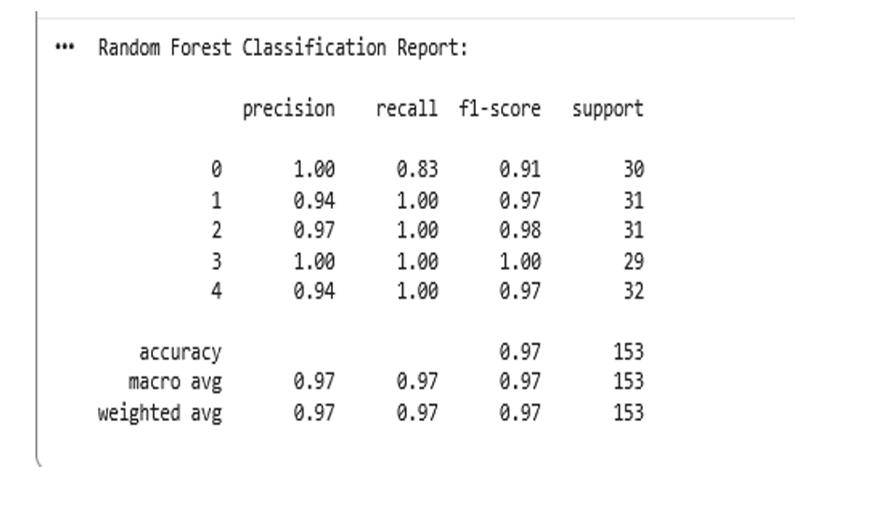
Testing & Validation
Random Forest achieved high performance across all classes with: Accuracy: ~97%High precision and recall values Balanced F1-score across all prediction levels

Slide 10
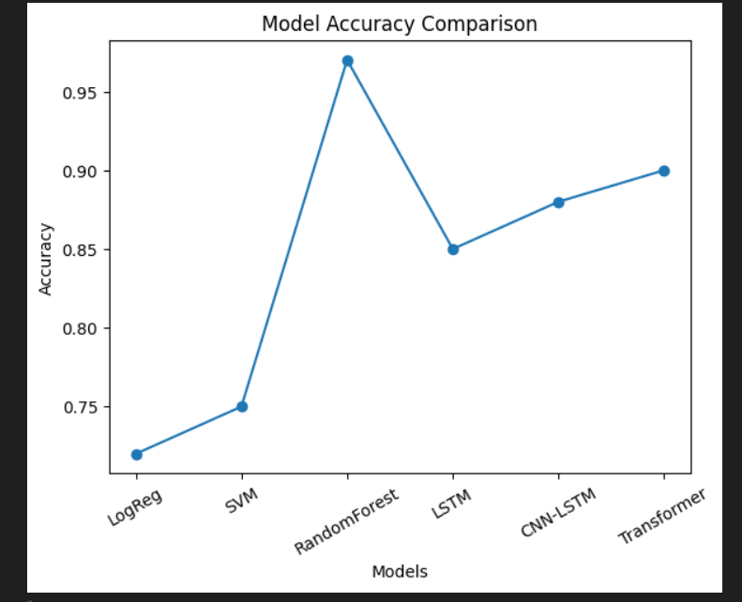
Testing & Validation
Comparison of different models shows: Random Forest achieved highest accuracy Deep learning models performed well Traditional ML models showed lower performance

Slide 11
Results, Analysis & Discussion
The proposed system successfully predicts multi-level stock price increases (3%, 5%, 7%, 9%).Random Forest achieved the best performance with high accuracy (~97%).The system effectively integrates sentiment analysis and technical indicators.
The model shows high precision, recall, and F1-score across all classes. Balanced performance indicates reliable prediction of high-rise events.
The system generates real-time predictions through a web application.Example output shows predicted rise level with confidence score.This demonstrates practical usability of the model.

Slide 12
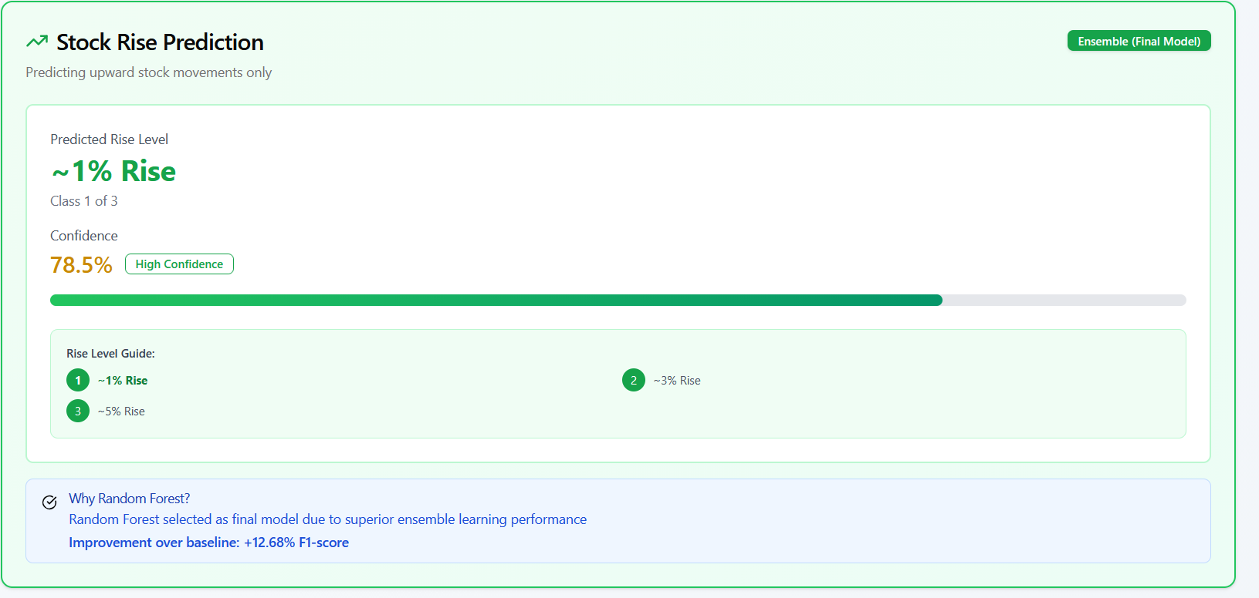
Results, Analysis & Discussion

Slide 13
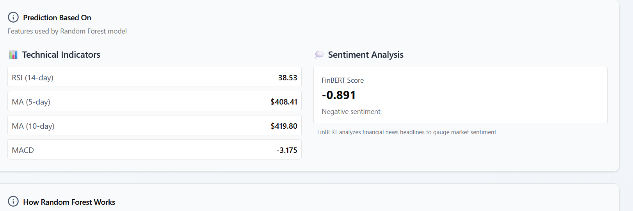
Results, Analysis & Discussion
Predictions are based on both technical indicators and sentiment analysis.Technical features include RSI, MACD, and moving averages.FinBERT is used to extract sentiment from financial news.

Slide 14
Results, Analysis & Discussion
Resampling techniques improved detection of rare high-rise events.Combining numerical and textual data enhanced prediction performance.The system provides reliable results for real-world stock prediction.
The proposed system overcomes limitations of existing models by providing multi-level predictions.The application-based design improves usability and accessibility.The system can support better investment decision-making.

Slide 15
Conclusion
Summary of project
The project presents an intelligent system for predicting multi-level stock price increases using sentiment analysis (FinBERT), technical indicators, and machine learning models. The integration of resampling techniques helped in handling class imbalance and improving prediction accuracy. Random Forest was selected as the final model due to its superior performance.
Expected outcomes or impact
The system provides accurate and reliable stock rise predictions, helping investors make informed decisions. The application-based implementation makes the system practical and user-friendly. It can be extended to real-time forecasting and applied to different financial markets for improved decision support.

Slide 16
References
Journals
[1] N. Bathla and P. Gupta, “FinBERT and LSTM-based novel model for stock price prediction using technical indicators and financial news,” International Journal of Electronic Business Research, vol. 20, no. 2, pp. 156–172, 2024.
[2] S. Halder, “FinBERT-LSTM: Deep learning based stock price prediction using news sentiment analysis,” arXiv preprint arXiv:2211.07392, 2022.
[3] N. V. Chawla, K. Bowyer, L. Hall, and W. Kegelmeyer, “SMOTE: Synthetic Minority Over-sampling Technique,” Journal of Artificial Intelligence Research, vol. 16, pp. 321–357, 2002.
[4] D. Vargas, B. S. L. P. Lima, and A. Evsukoff, “Deep learning for stock market prediction using technical indicators and sentiment analysis,” IEEE International Joint Conference on Neural Networks (IJCNN), pp. 1419–1426, 2017.
[5] I. Goodfellow, Y. Bengio, and A. Courville, Deep Learning, MIT Press, 2016.
[6] C. M. Bishop, Pattern Recognition and Machine Learning, Springer, 2006

